Slide 1

2019-nCoV categorization and prediction: A deep learning analysis
Shuja Sajjad

Slide 2
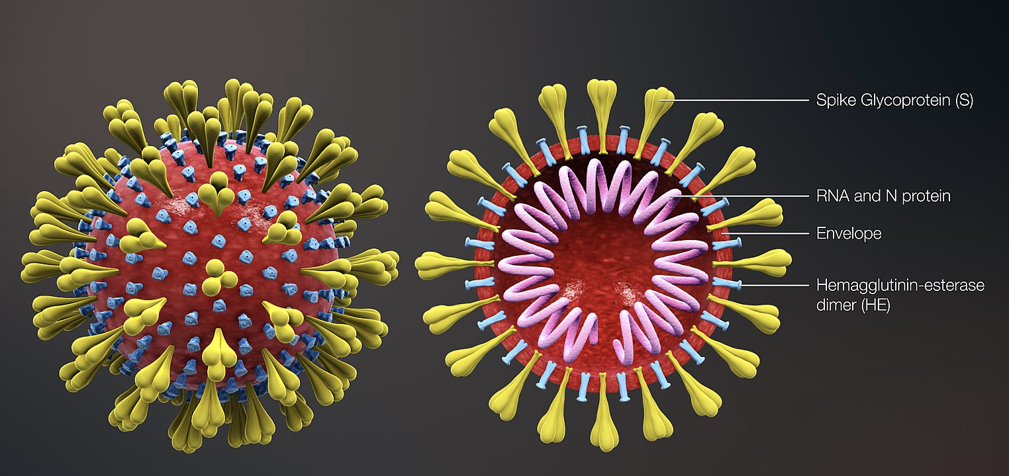
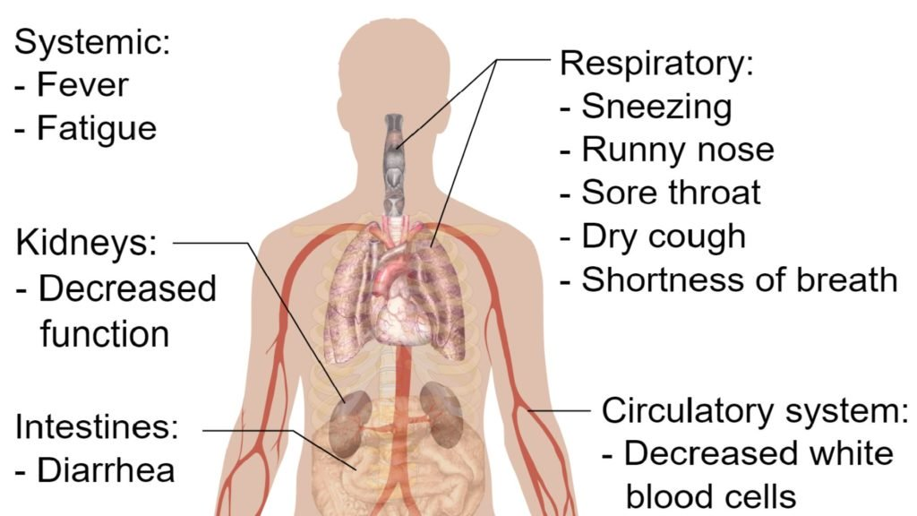
2019’s novel coronavirus
• Coronavirus (COVID-19) is an illness caused by a virus that can spread from person to person.
• The virus that causes COVID-19 is a new coronavirus that has spread throughout the world.
• COVID-19 symptoms can range from mild (or no symptoms) to severe illness.
• Is observed to have originated from China, with the first recorded cases in November 2019.
• The resulting illness is observed to have a strong respiratory component.

Slide 3
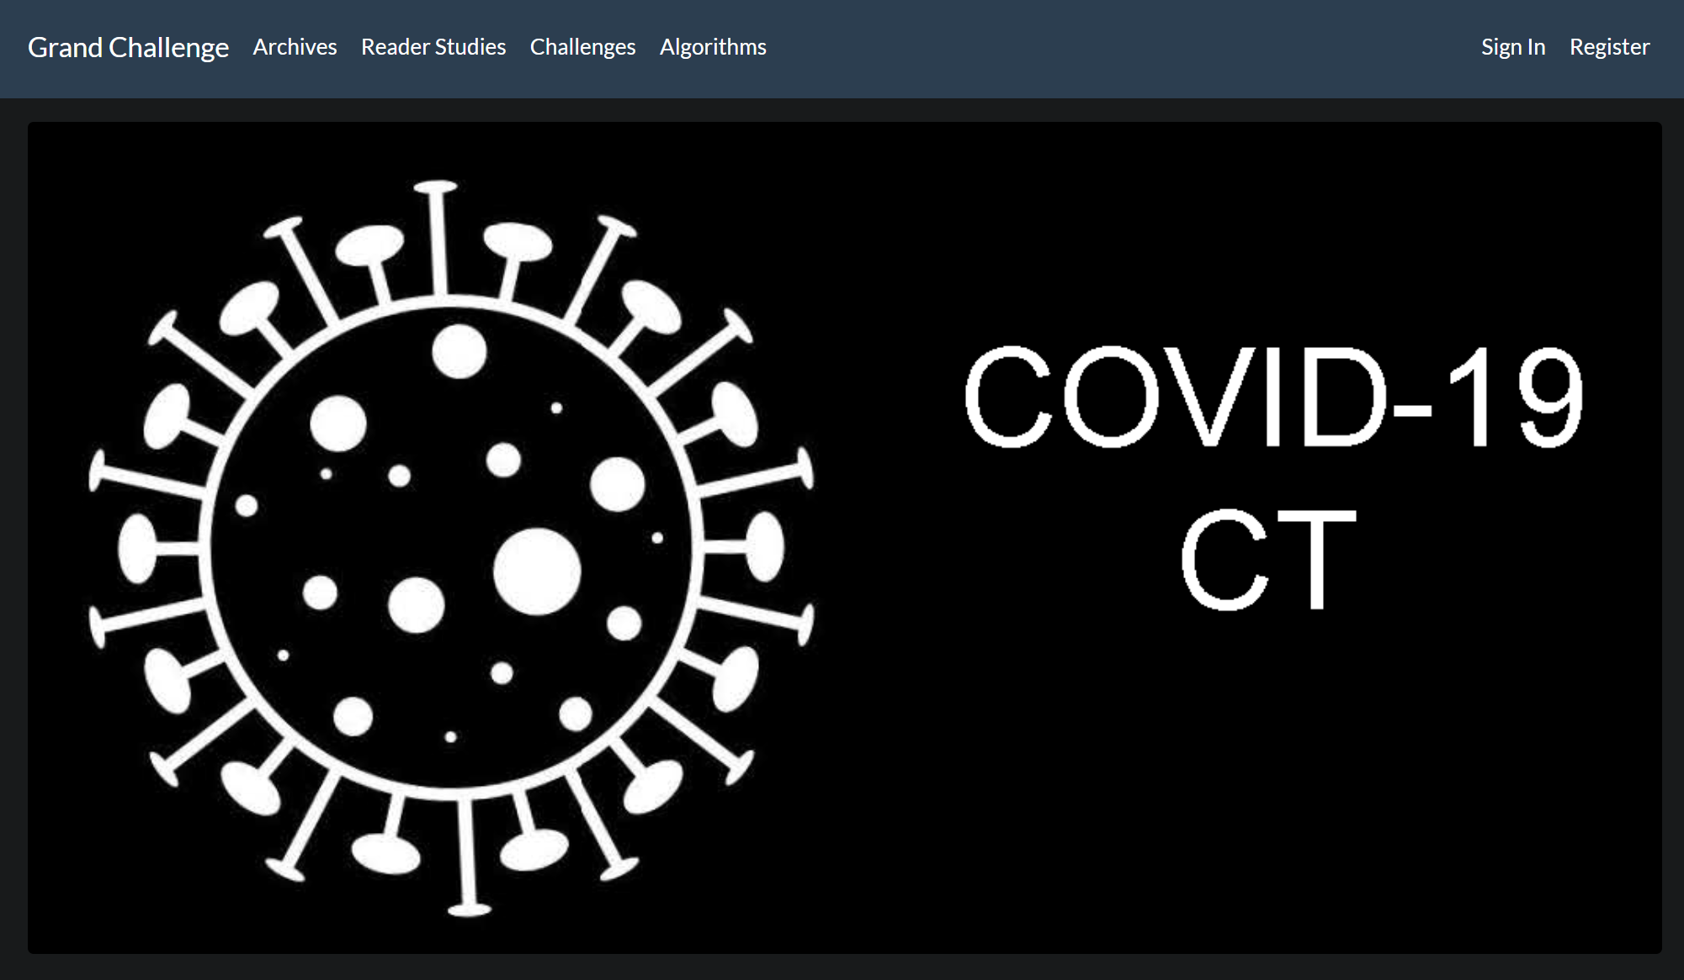
Taking on the Challenge
∙ “To mitigate the inefficiency and shortage of existing tests for COVID-19, we propose this competition to encourage the development of effective Deep Learning techniques to diagnose COVID-19 based on CT images.”
The problem in this challenge is to classify each CT image into positive COVID-19 (the image has clinical findings of COVID-19) or negative COVID-19 (the image does not have clinical findings of COVID-19).

Slide 4

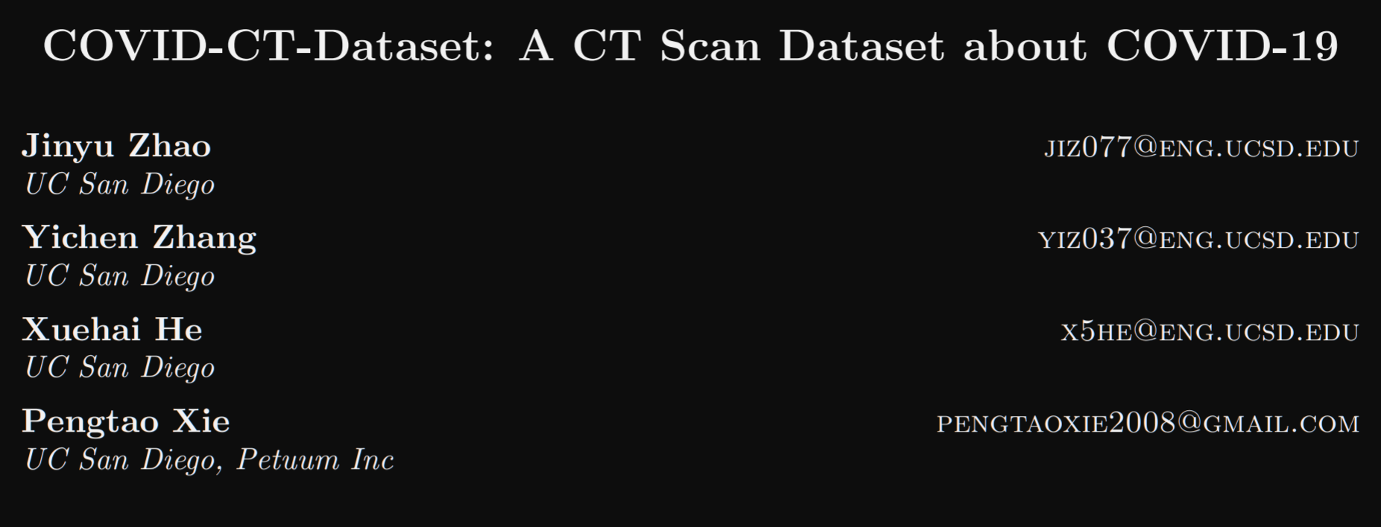
Finding the data
∙ Many interesting open data sets available through the Grand Challenge.
∙ UCSD collected various scans through liaising with local doctors from affected regions in China.
∙ Not the cleanest, or most comprehensive, data but provided high resolutions for potential deep learning analysis.
∙ Over 700 images, including limited metadata.

Slide 5


Part 1: Metadata analysis
In hope of uncovering trends and relationships within the patients’ medical backgrounds.

Slide 6
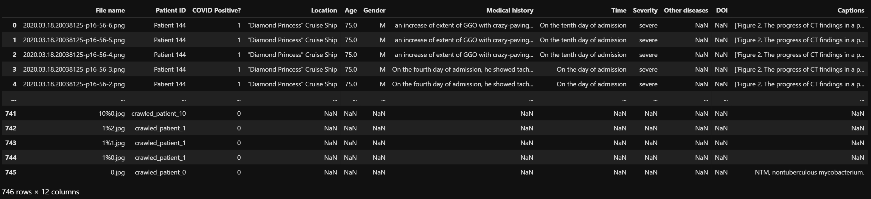
Metadata analysis
∙ Result of consolidating data from various sources.
∙ Included metadata of scans, but in need of significant cleaning before analysis.

Slide 7
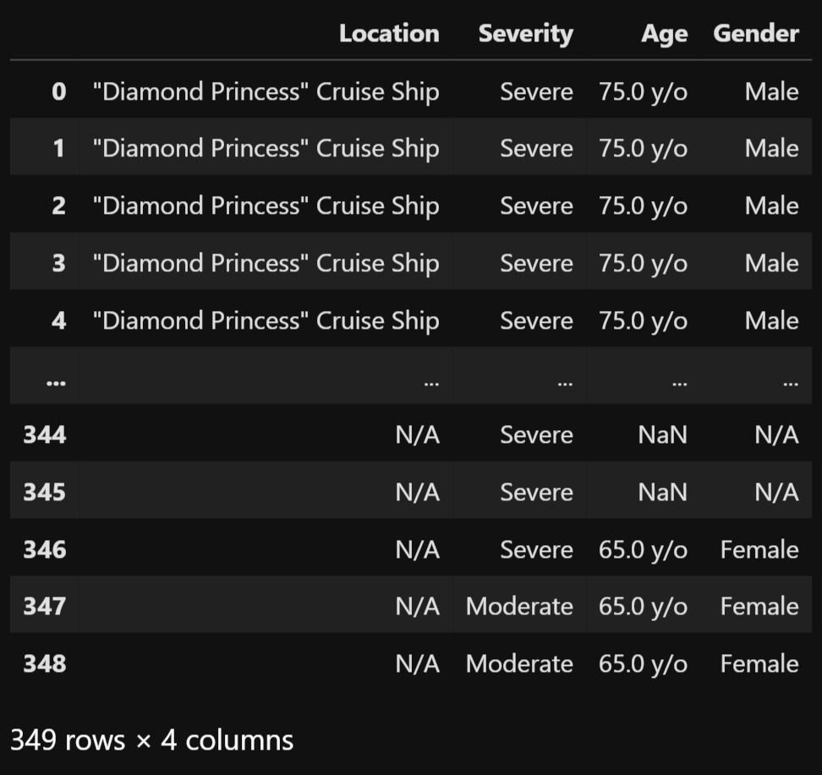
Metadata analysis
∙ Decided on a focused analysis of Location, Severity (of illness), Age, and Gender.

Slide 8
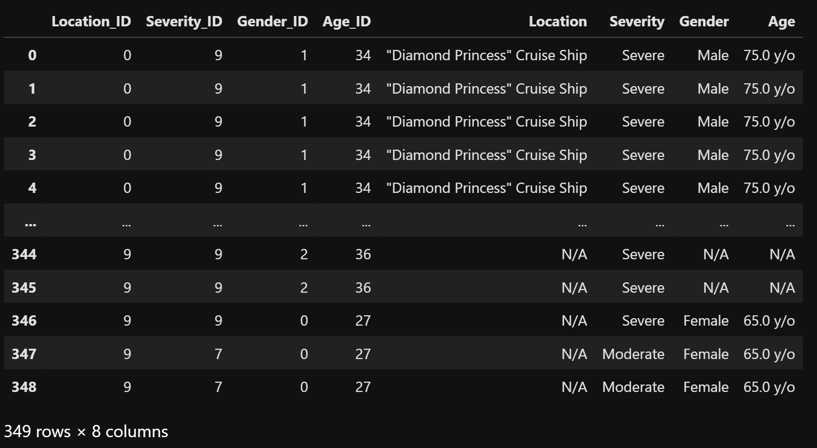
Hot encoding needed
∙ Converted ‘Location’, ‘Severity’, ‘Gender’, and ‘Age’ string values into hot encodes in order to prepare for the sklearn analysis.

Slide 9
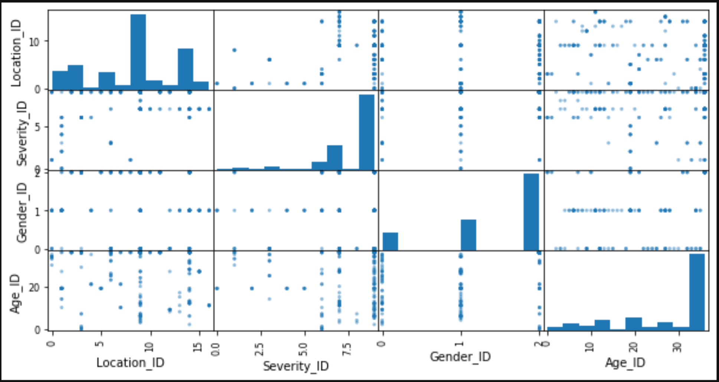
Not so ‘hot’ results
∙ Instead of having histograms on the diagonals to display density, we could view the more aesthetically pleasing kernel density estimation(KDE).
∙ KDE is a non-parametric way to estimate the probability density function of any variable we wish to view.
∙ No visually discernable trends upon initial analysis.

Slide 10
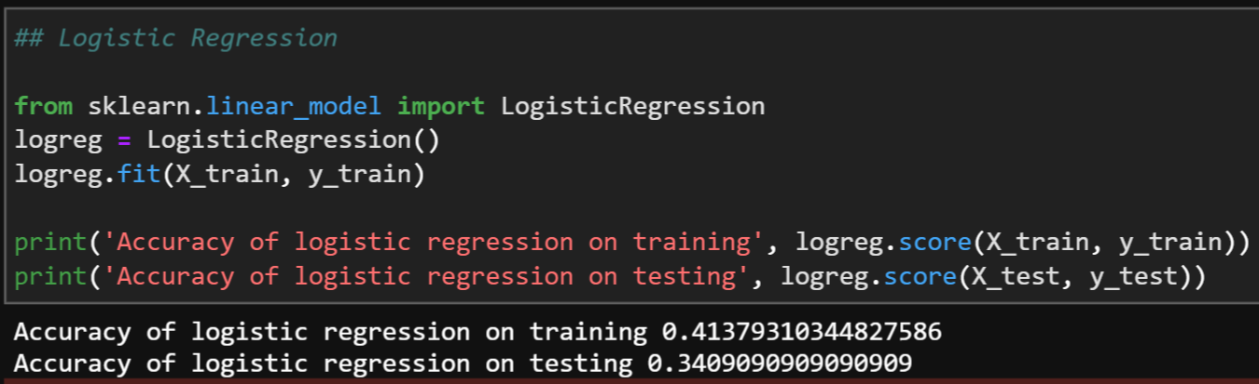
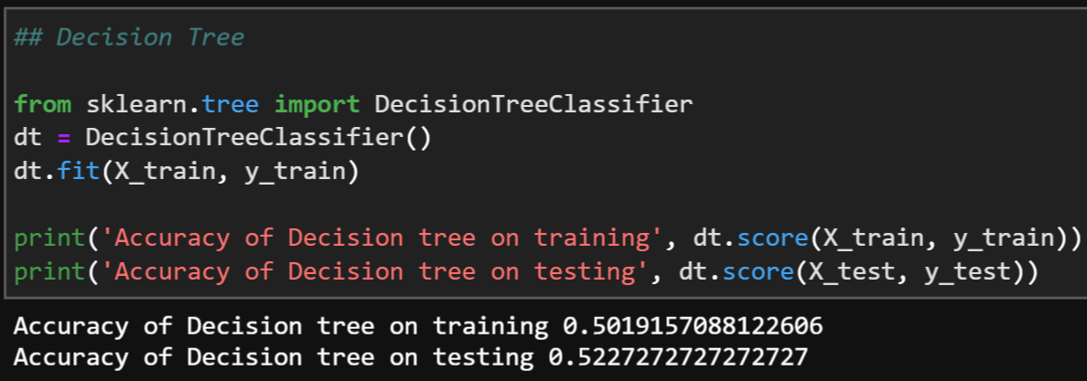
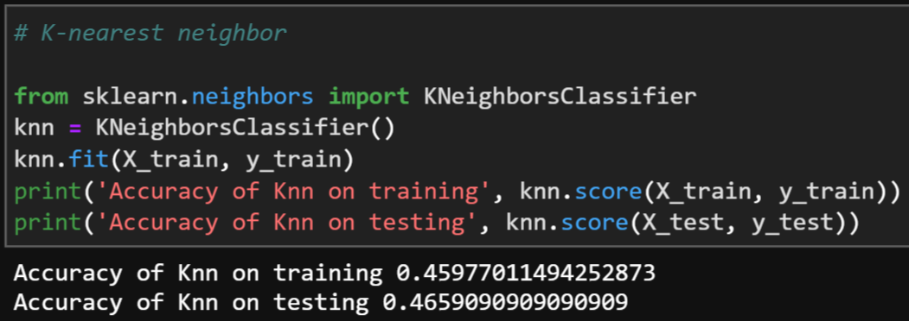
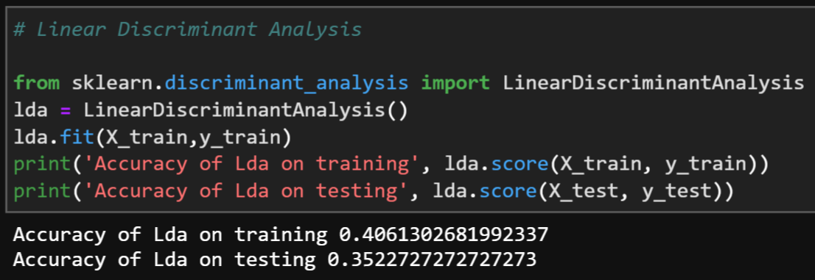
Not so ‘hot’ results
∙ Above models give a max accuracy of ~50%

Slide 11
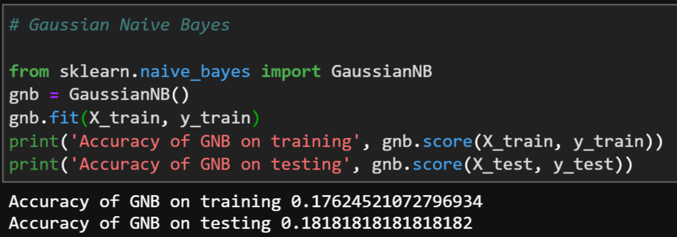
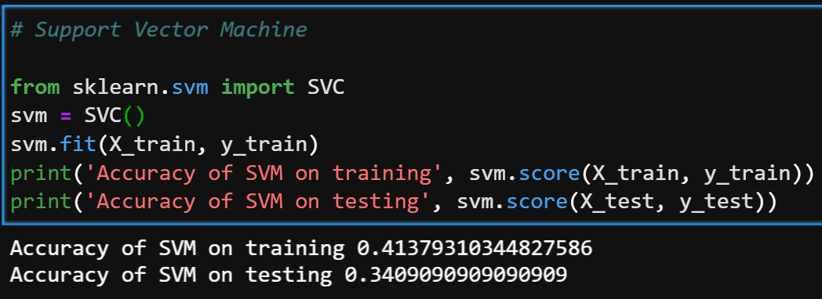
Not so ‘hot’ results
∙ Above models give a max accuracy of ~41%
∙ We can conclude that the metadata itself does not show a robust relationship between the Location, Illness Severity, Age, and Gender of the patients.

Slide 12

Part 2: ct-scan analysis using neural networks and machine learning

Slide 13
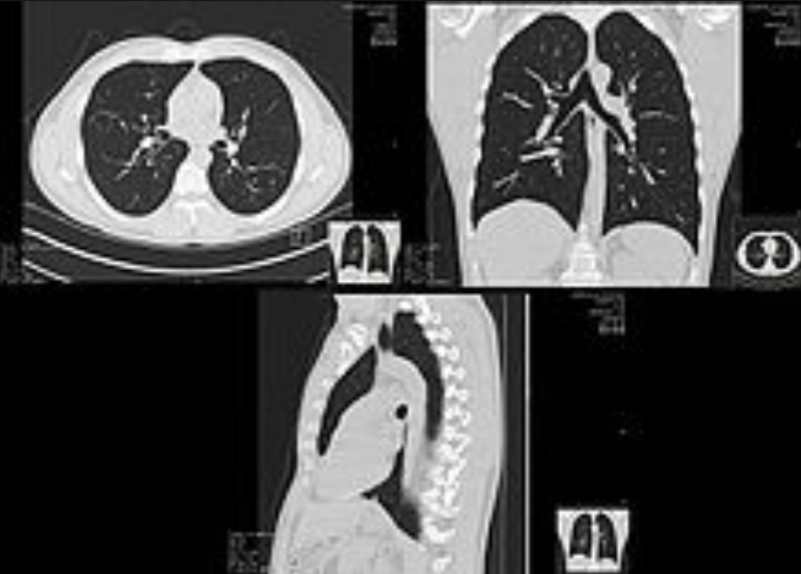
what are ct-scans? (Computed tomography)
A CT scan, or computed tomography scan, is a medical imaging procedure that uses computer-processed combinations of many X-ray measurements taken from different angles to produce cross-sectional images of specific areas of a scanned object, allowing the user to see inside the object without cutting.

Slide 14
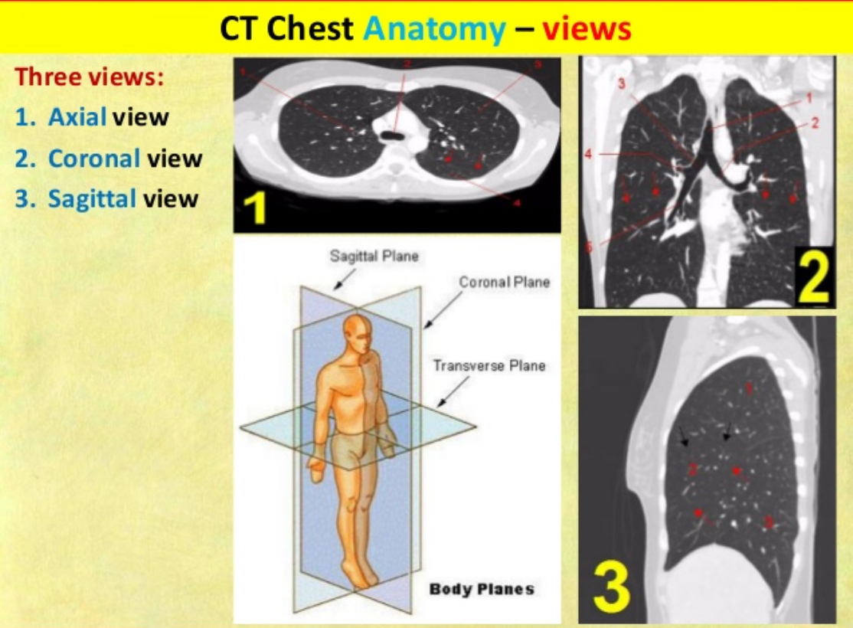
what are ct-scans? (Computed tomography)
∙ Our CT scan data set includes over 700 images of 2019-nCoV-Positive and 2019-nCoV-Negative patients.
∙ All scans are from the transverse (also known as axial) view.

Slide 15

Computational data crunching
∙ Our image computational data set will certainly overwhelm most PC hardware.
∙ Majority of high-end machine learning is performed in the cloud, on dedicated server farms and GPU’s (graphics processing units).

Slide 16
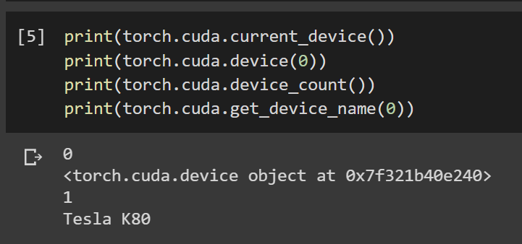
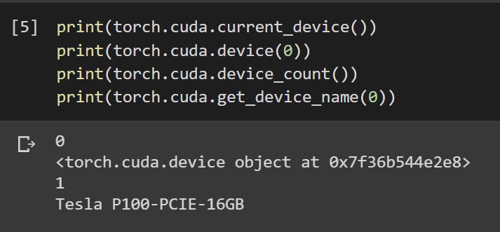
horsepower matters
∙ Google Colab allocates specific GPU’s based to the data complexity within the notebook.
∙ Tesla K80: Analysis within ~15 minutes.
∙ Tesla P100: Analysis within ~1-2 minutes.

Slide 17
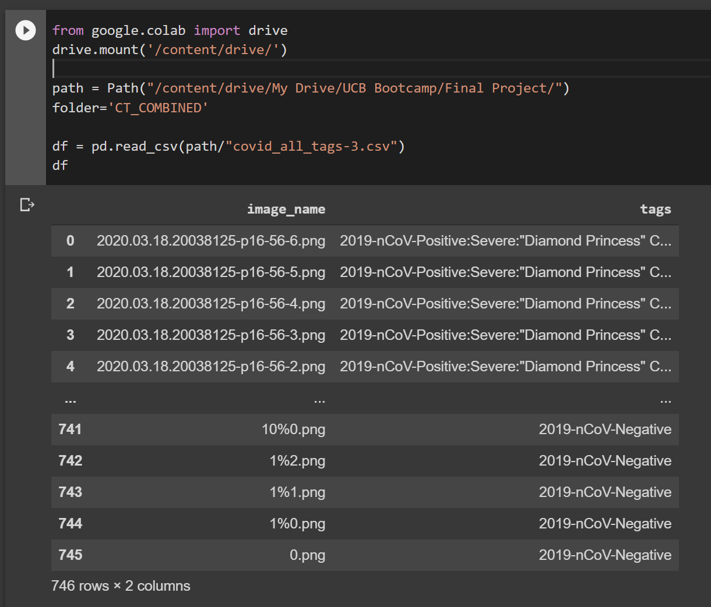
find your “path”
∙ Google Colab also connects seamlessly with Google Drive (naturally).

Slide 18
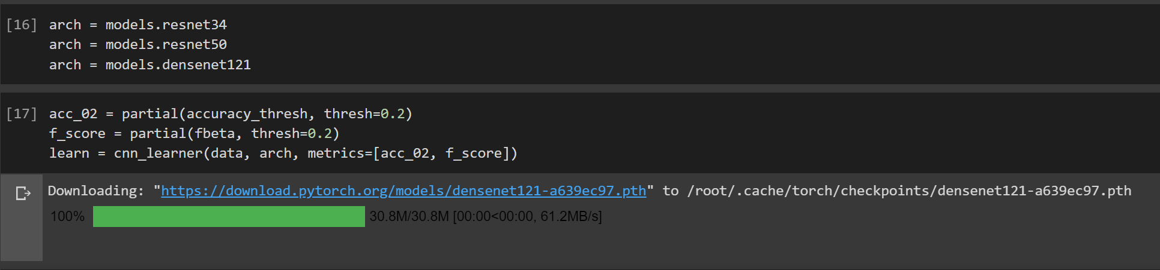
“model” behavior
∙ For the purposes of this project, we will be using the Resnet34, Resnet50, and Densenet121 models.

Slide 19
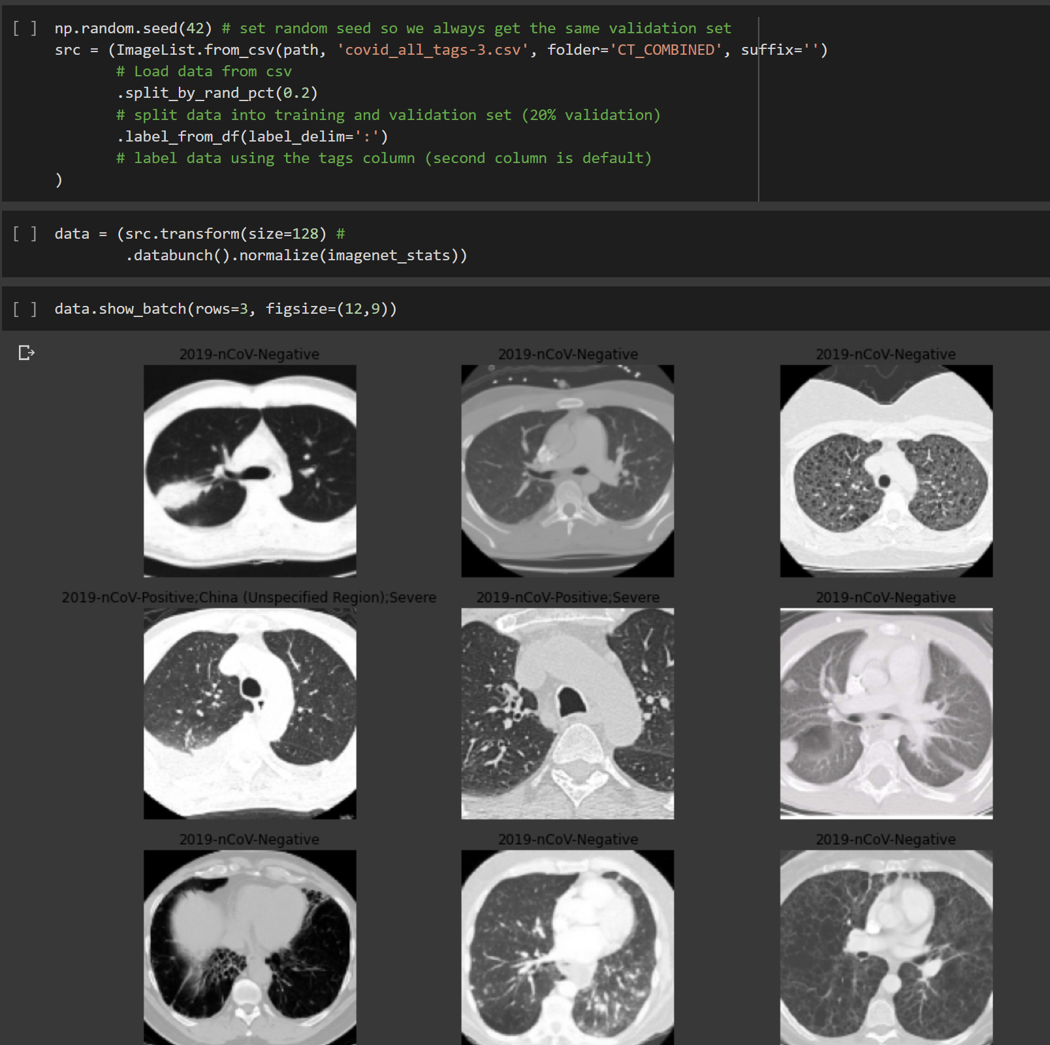
loading the images

Slide 20
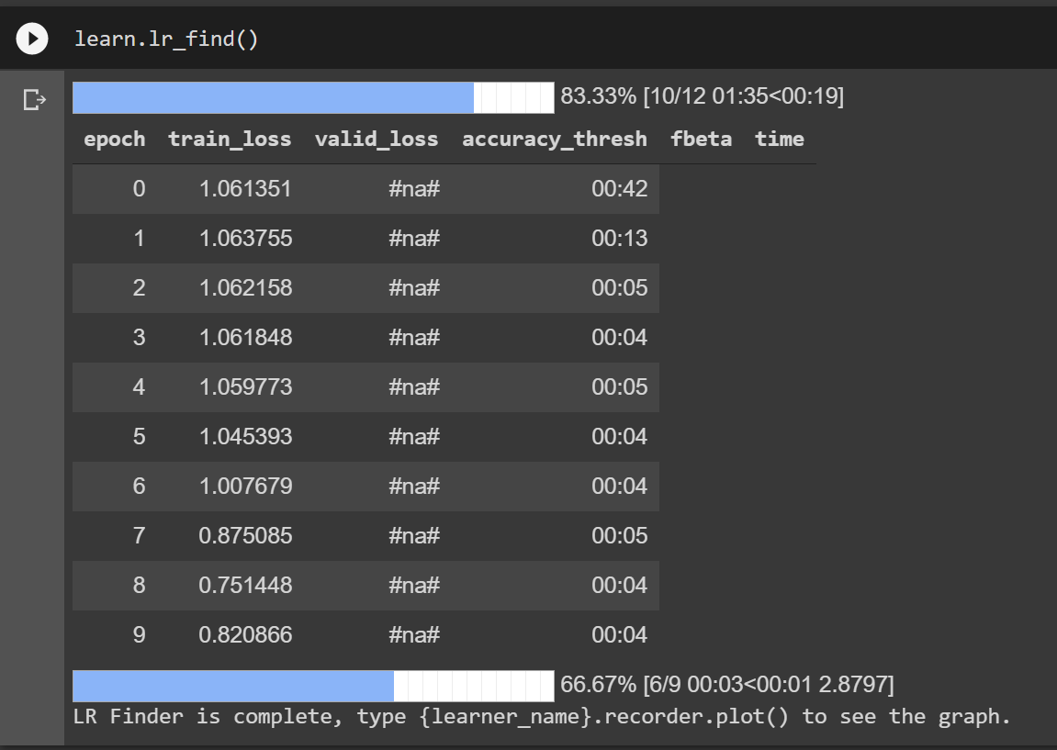
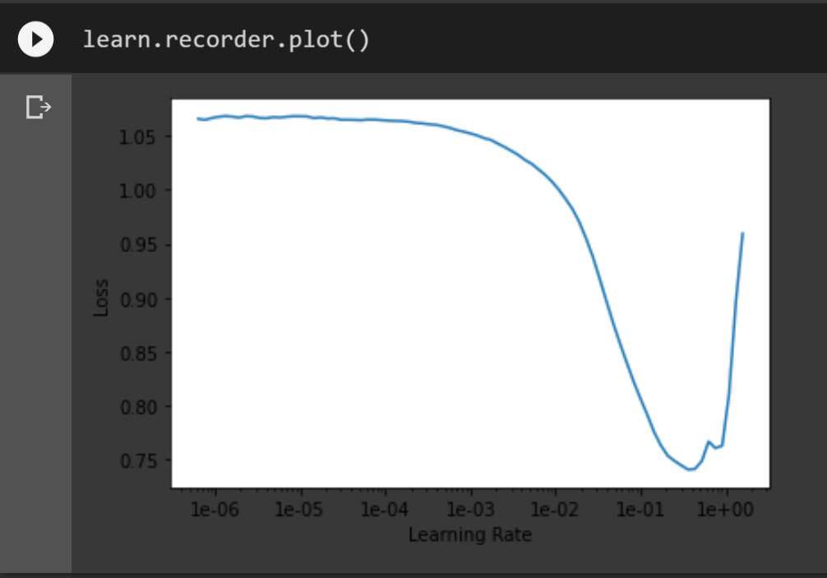
finding the optimal lr
∙ Finding the optimum learning rate is key to training an accurate model.
∙ A suitable learning rate (lr) is 1e-01 here (0.01).

Slide 21
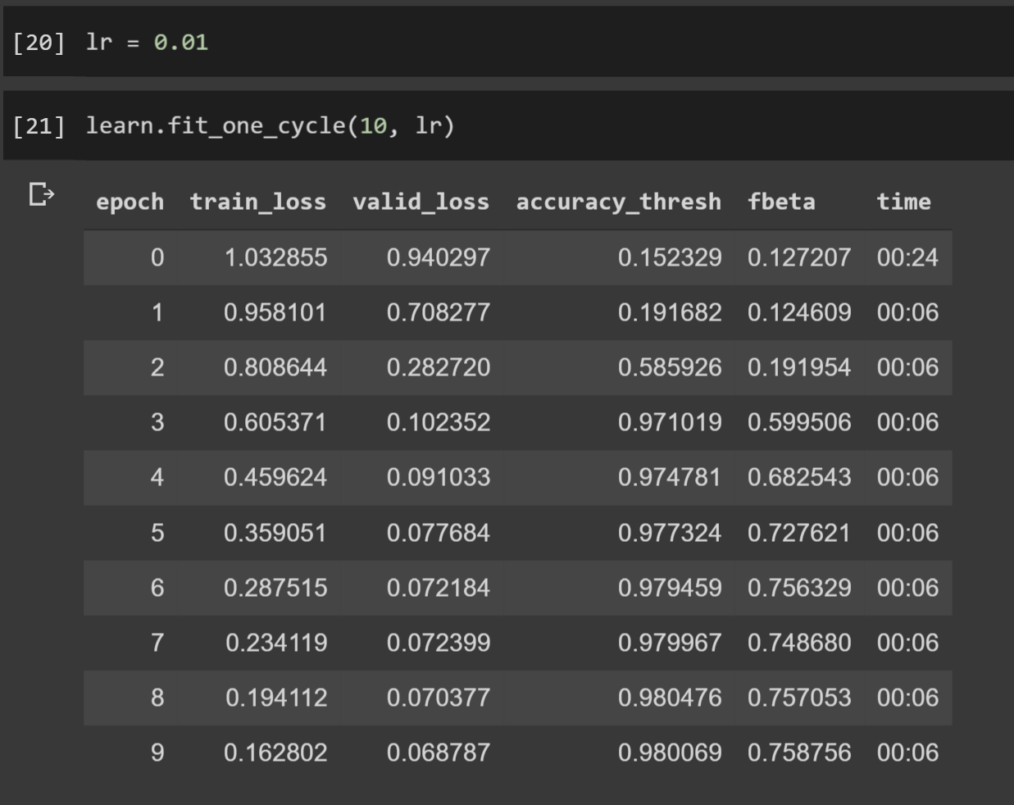
Training the model
∙ Using our determined learning rate, we begin to train our model with the CT scan data set, in this case setting 10 epochs.
∙ fbeta scores are the calculated mean of the precision and recall rate.

Slide 22
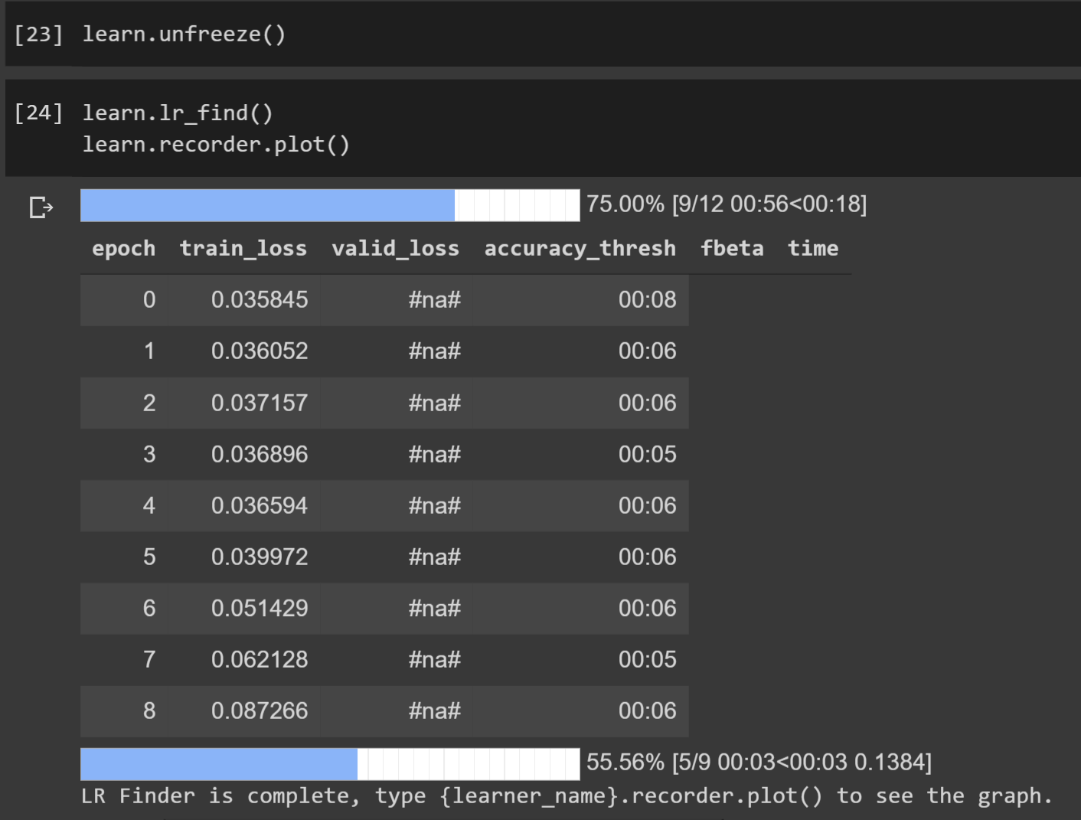
time to fine tune our model..
∙ We can ‘unfreeze’ the layers of our image files, enabling our learner to scan more than just the superficial top layer of each image.

Slide 23
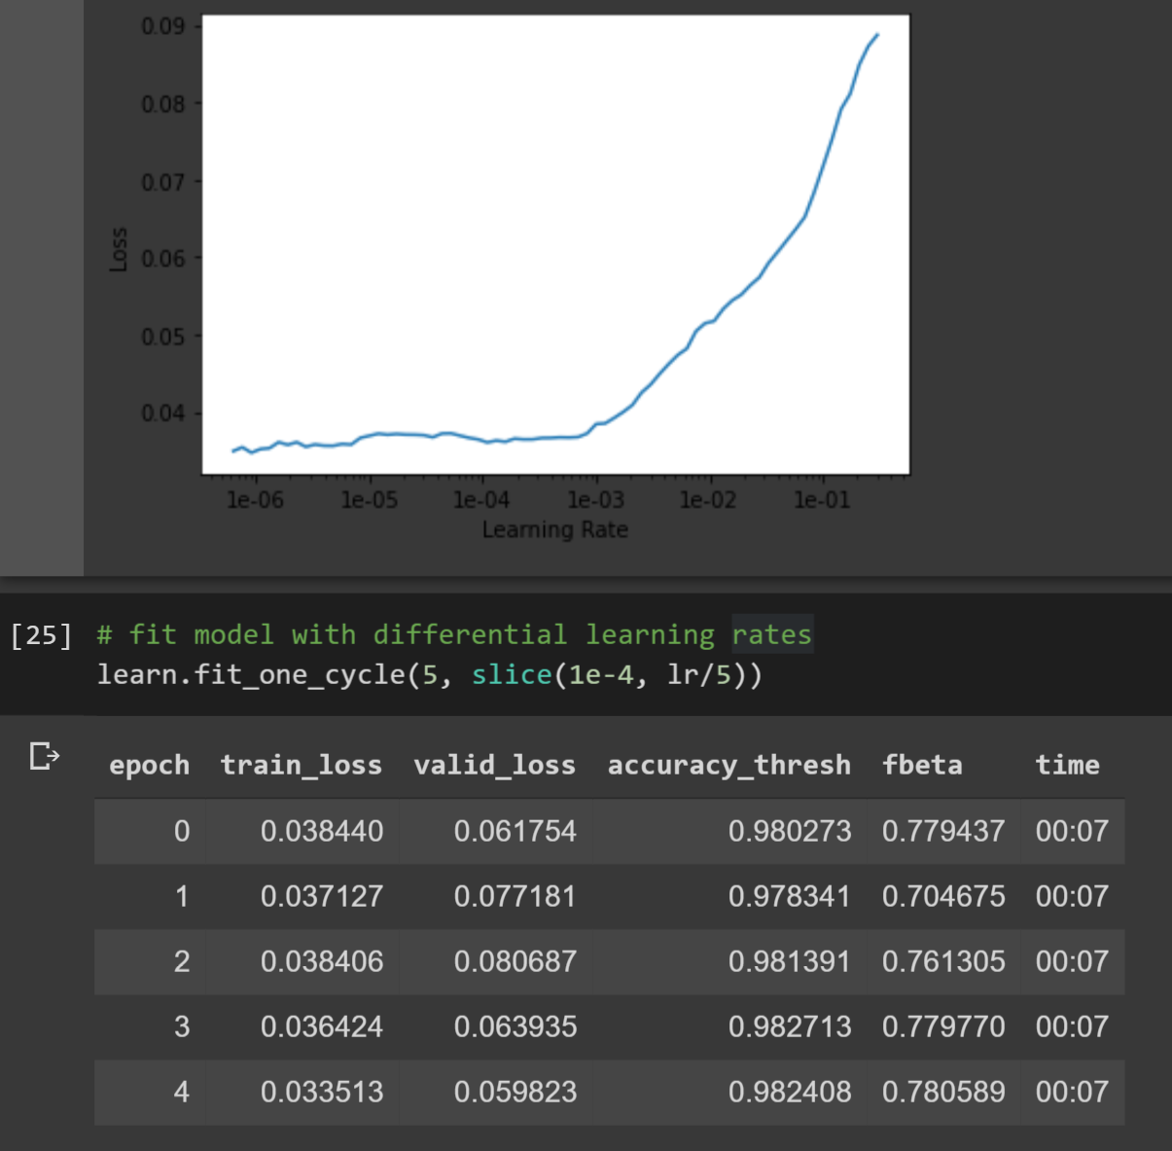
time to fine tune our model..
∙ Unfreezing the model gives us a new learning rate for the deeper scan.
∙ We now retrain our model again with the new optimal learning rate (1e-4).

Slide 24
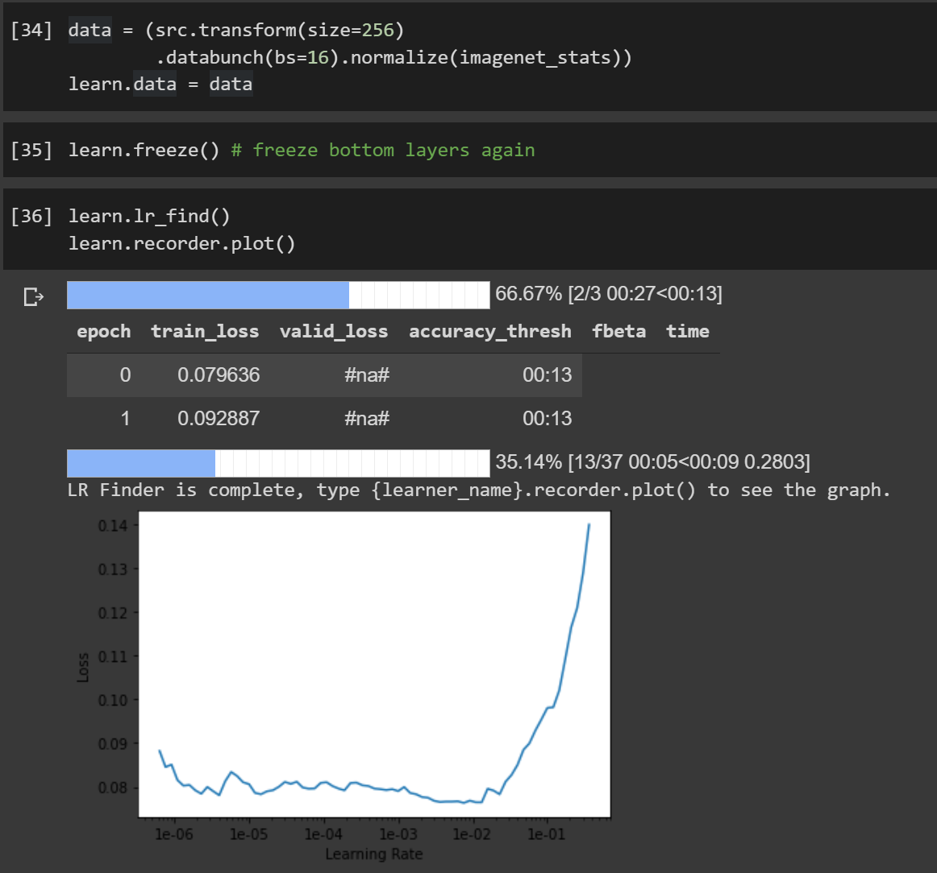
increase resolution to further fine tune our model and prevent overfitting

Slide 25
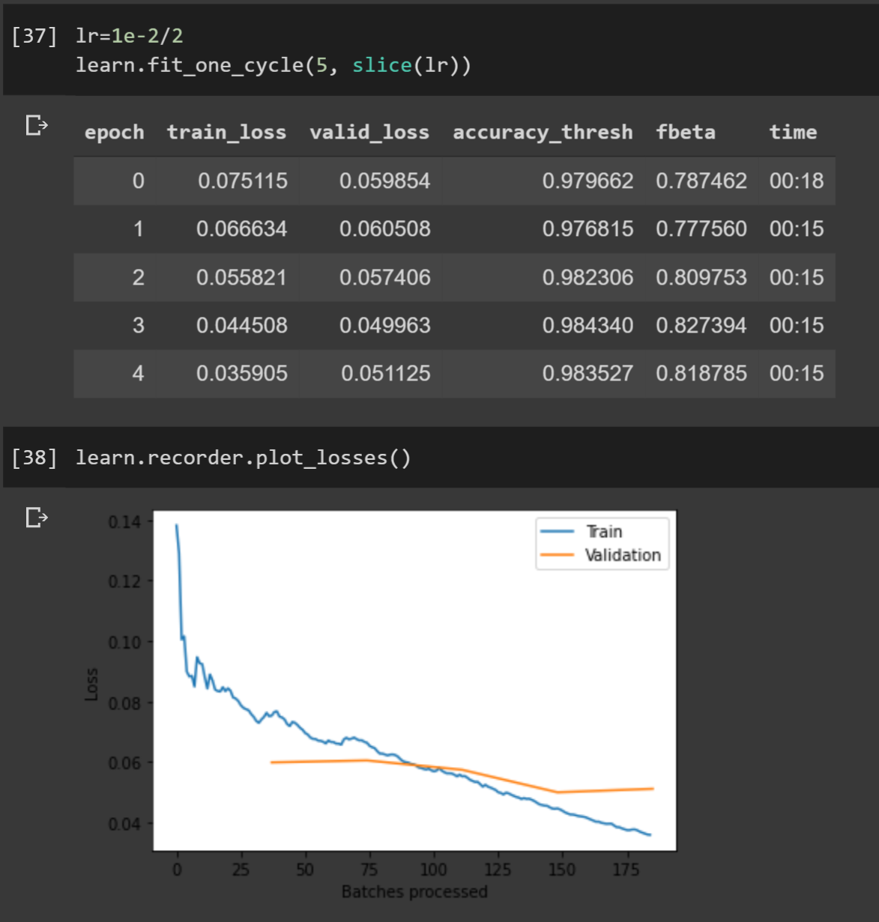
increase resolution to further fine tune our model and prevent overfitting

Slide 26
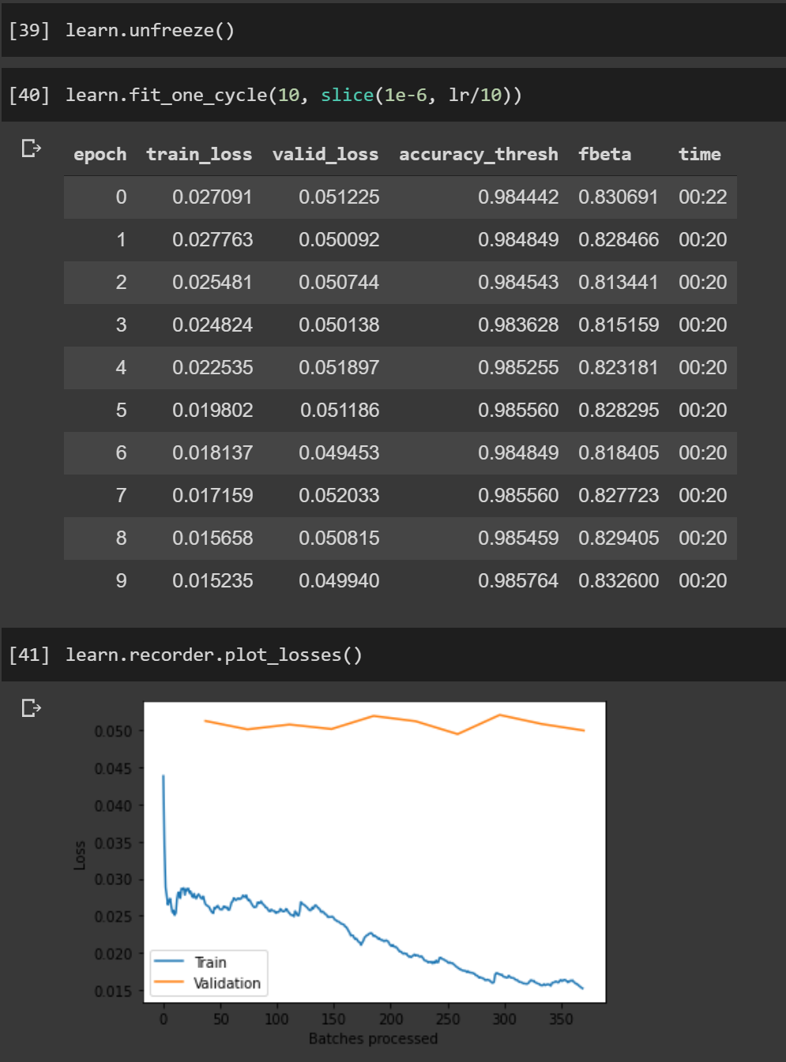
increase resolution to further fine tune our model and prevent overfitting
∙ Final accuracy threshold at 98.58% (!)
∙ Validation losses have leveled off, indicating that our model has learned and matured in regards to our training.

Slide 27
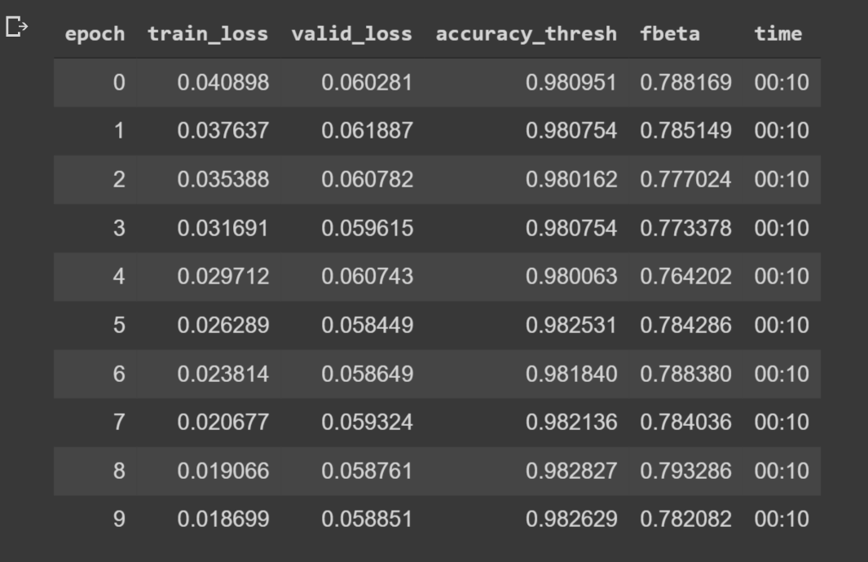
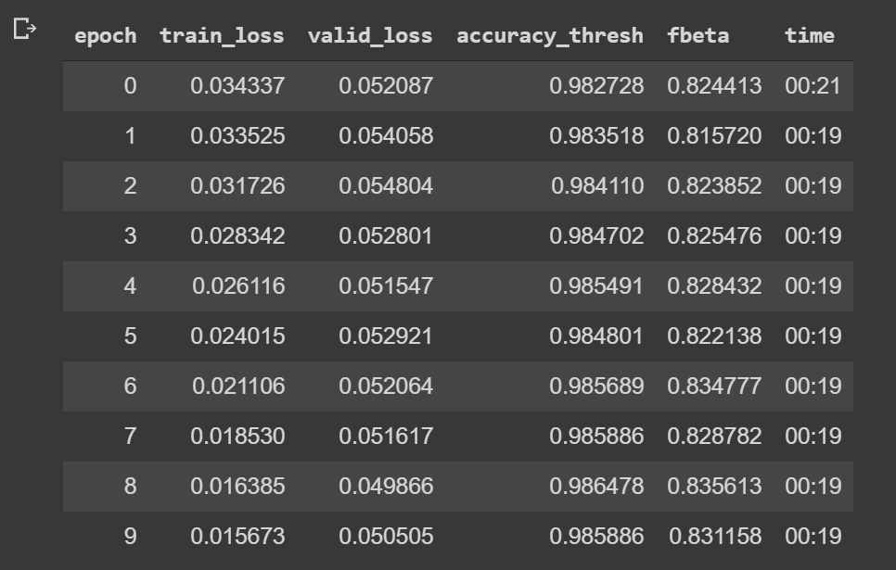
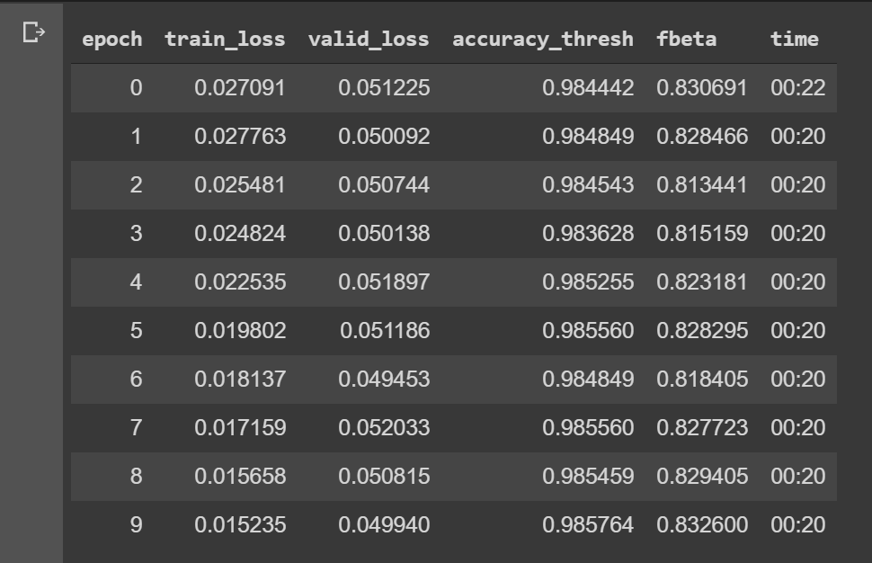
Pretraining model comparisons
∙ Resnet34
∙ Resnet50
∙ Densenet121

Slide 28

confused? high level overview:
∙ Increase image resolution and reload images
∙ Find new learning rate of model
∙ Train model based on new learning rate
∙ Unfreeze images to scan deeper
∙ Find new unfrozen learning rate
∙ Retrain model based on new, unfrozen learning rate
∙ Load images
∙ Find learning rate of model
∙ Train model based on learning rate
∙ Unfreeze images to scan deeper
∙ Find unfrozen learning rate
∙ Train model based on new, unfrozen learning rate

Slide 29
got the sweet .pkl! Time to deploy!
.pkl file
Contains all the weights, measures, and calculations of our machine learning training.
https://covid19-ct-ai.onrender.com/

Slide 30

acknowledgements
D.R.E.W 👑
Jeremy Howard (fast.ai) 🤖
UCSD School of Medicine 🩺
Healthcare workers in China during the initial outbreak (and beyond) ⚕️

Slide 31

Questions? Comments?

